Slide 1
Lane Segmentation Week 3
HCT CV Course

Slide 2
主要内容

Slide 3
学习目标
掌握ResNet的原理和实现
了解ResNet系列模型
掌握U-Net的原理和实现

Slide 4
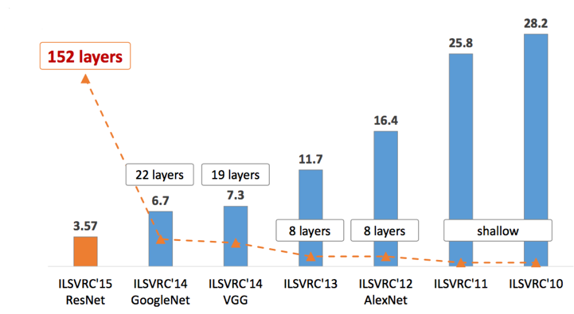







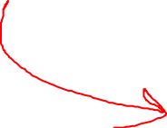











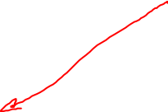
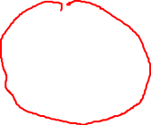


ResNet

Slide 5
Notes

Slide 6
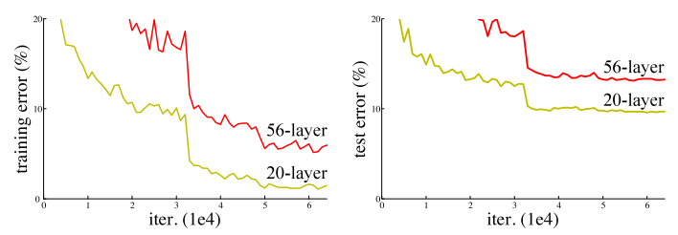









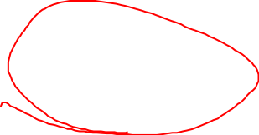
















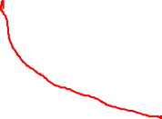
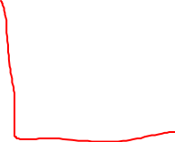
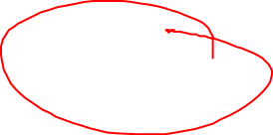






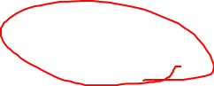



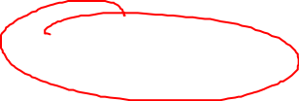

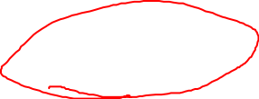










Deep Network Degradation

Slide 7


Notes

Slide 8
Residual Learning

Slide 9
Residual Learning

Slide 10

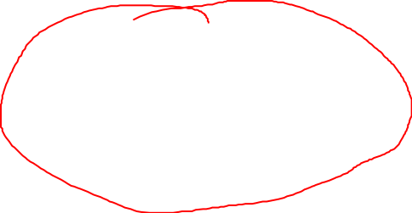







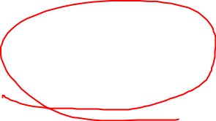

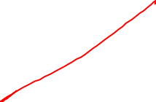




















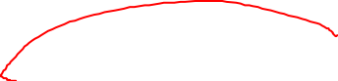



Notes

Slide 11




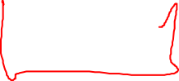
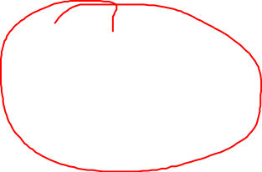












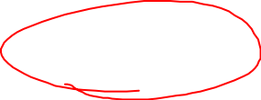
























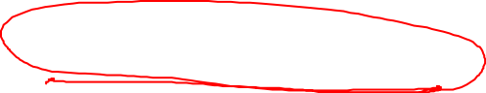




Identity Mapping Shortcut
唯一更新qq932891086
1x1 Convolution

Slide 12
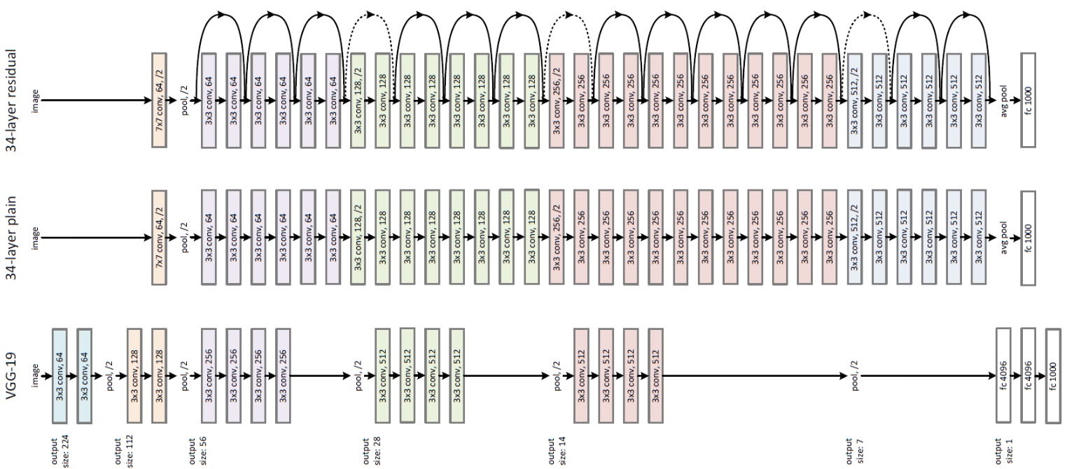

















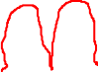

ResNet

Slide 13
















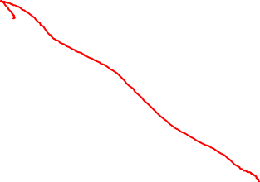



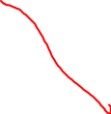










































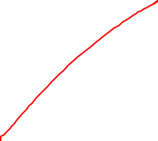




ResNet

Slide 14
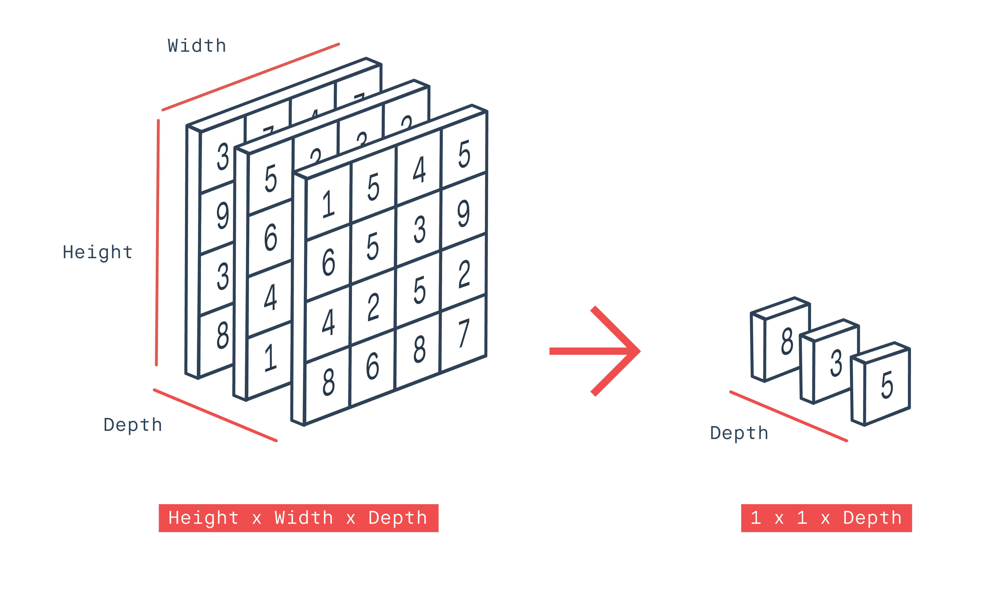

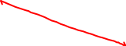
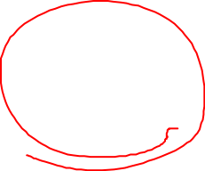






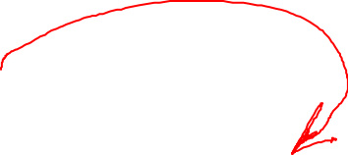










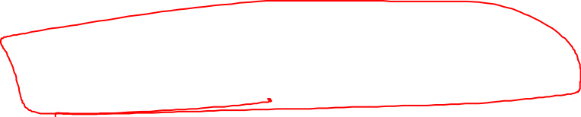
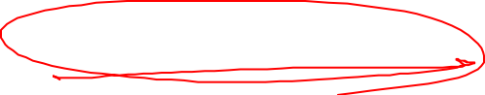







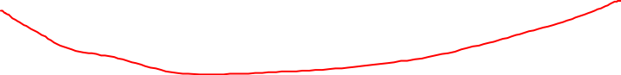
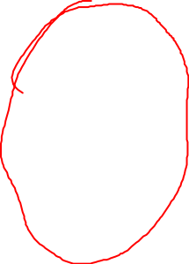






















Global Average Pooling

Slide 15
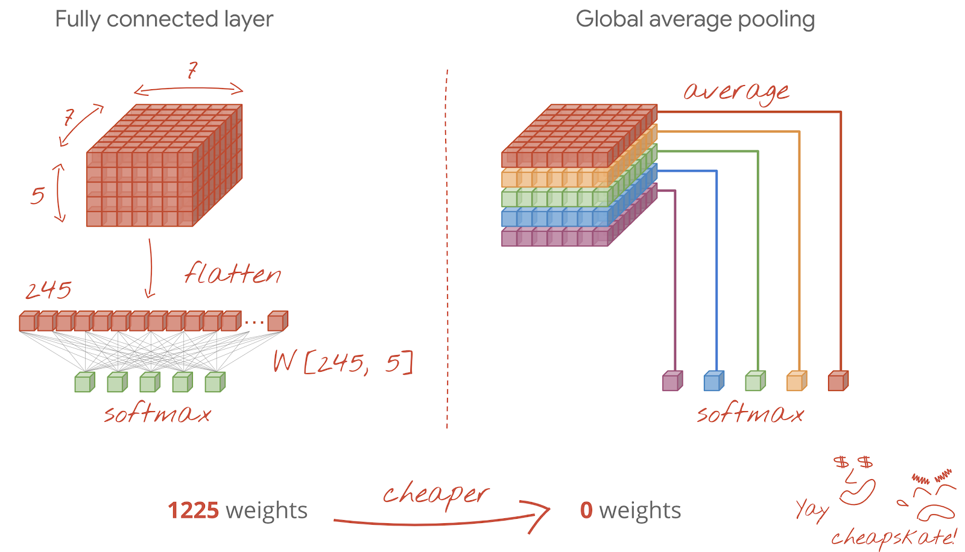









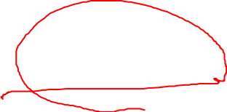

















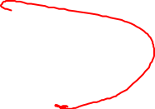


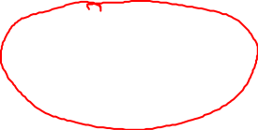










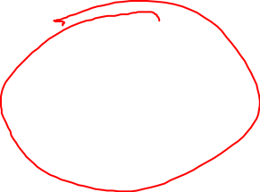


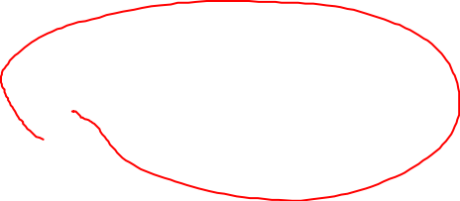





Global Average Pooling

Slide 16
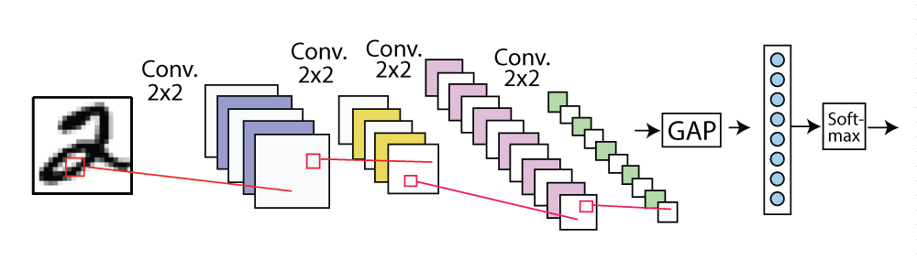

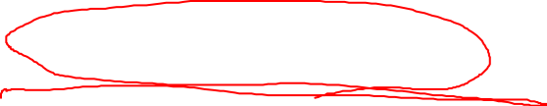


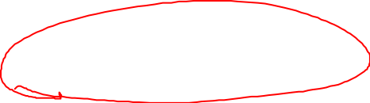
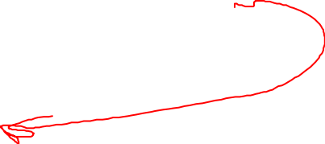



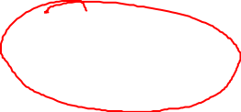
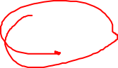




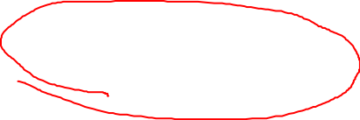













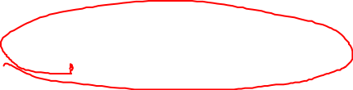






Global Average Pooling
torch.nn.AdaptiveAvgPool2d(output_size)
tf.keras.layers.GlobalAvgPool2D

Slide 17












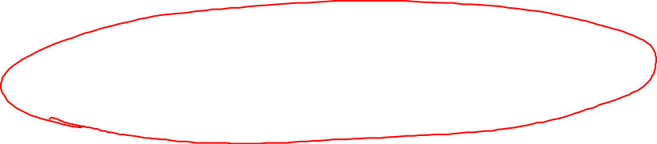

















Spatial Pyramid Pooling

Slide 18
Notes

Slide 19




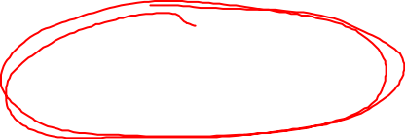




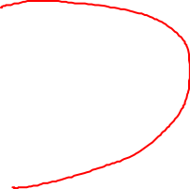
































































BottleNeck

Slide 20
















































Code

Slide 21


































ResNet新发展
ResNeXt
ResNeXt-Attention
ResNeXt WSL

Slide 22









































ResNeXt

Slide 23



















































































SENet
唯一更新qq932891086

Slide 24












































ResNeXt-Attention

Slide 25




























































ResNeXt WSL

Slide 26


















































































Notes

Slide 27
































































































U-Net

Slide 28














Human Pose Estimation

Slide 29
Human Pose Estimation

Slide 30
Encoder
ResNet50
Input size
SAME vs VALID padding

Slide 31
Decoder
Upsampling vs Transposed convolutions

Slide 32
bilinear interpolation
nn.Upsample(mode='bilinear', scale_factor=2)

Slide 33
Transposed Convolution
nn.ConvTranspose2d(in_size, out_size, kernel_size=2, stride=2)

Slide 34
Skip
唯一更新qq932891086
crop
cat

Slide 35
Code

Slide 36
模型对比
FCN

Slide 37
模型对比
Deeplab v3+

Slide 38
课程总结
ResNet的原理和实现
ResNet系列
U-Net的原理和实现

Slide 39
重难点
ResNet
Encoder-Decoder

Slide 40
课程作业
不使用API实现双线性差值算法放大图片
实现U-Net-ResNet网络模型
实现ResNeXt

Slide 41
参考资料
Deep Residual Learning for Image Recognition
https://arxiv.org/abs/1512.03385
ResNet-Pytorch
https://github.com/pytorch/vision/blob/master/torchvision/models/resnet.py
ResNet-Keras
https://github.com/fchollet/deep-learning-models/blob/master/resnet50.py

Slide 42
参考资料
U-Net: Convolutional Networks for Biomedical Image Segmentation
https://arxiv.org/abs/1505.04597
U-Net-Pytorch
https://github.com/jvanvugt/pytorch-unet/blob/master/unet.py

Slide 43
Next Week

Slide 44
Next Week

Slide 45
Project
https://aistudio.baidu.com/aistudio/competition/detail/5
https://github.com/gujingxiao/Lane-Segmentation-Solution-For-BaiduAI-Autonomous-Driving-Competition

Slide 46
Notes

Slide 47

一所专注前沿互联网技术领域的创新实战大学

